Slide 1
Introduction to Classification

Slide 2
What is classification?
A machine learning task that deals with identifying the class to which an instance belongs
A classifier performs classification
Classifier
Category of document? {Politics, Movies, Biology}
( Textual features : Ngrams )
Test instance
Attributes
(a1, a2,… an)
( Age, Marital status,
Health status, Salary )
Discrete-valued
Class label
( Perceptive inputs )
Issue Loan? {Yes, No}
Steer? { Left, Straight, Right }

Slide 3
Classification learning
Training
phase
Testing
phase
Learning the classifier
from the available data
‘Training set’
(Labeled)
Testing how well the classifier
performs
‘Testing set’

Slide 4
Generating datasets
Methods:
  Holdout (2/3rd training, 1/3rd testing)
  Cross validation (n – fold)
    Divide into n parts
    Train on (n-1), test on last
    Repeat for different combinations
  Bootstrapping
    Select random samples to form the training set

Slide 5
Evaluating classifiers
Outcome:
  Accuracy
  Confusion matrix
  If cost-sensitive, the expected cost of classification ( attribute test cost + misclassification cost)
  etc.

Slide 6
Decision Trees

Slide 7
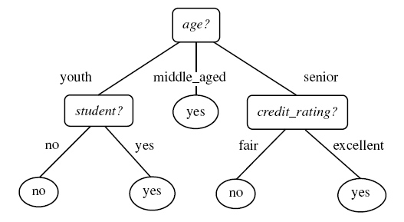
Example tree
Intermediate nodes : Attributes
Edges : Attribute value tests
Leaf nodes : Class predictions
Example algorithms: ID3, C4.5, SPRINT, CART
Diagram from Han-Kamber

Slide 8
Decision Tree schematic
Training data set
a1 a2 a3 a4 a5 a6
a1 a2 a3 a4 a5 a6
X
Y
Z
Impure node,
Select best attribute
and continue
Impure node,
Select best attribute
and continue
Pure node,
Leaf node:
Class RED

Slide 9

Decision Tree Issues
How to avoid overfitting?
Problem: Classifier performs well on training data, but fails
to give good results on test data
Example: Split on primary key gives pure nodes and good
accuracy on training – not for testing
Alternatives:
Pre-prune : Halting construction at a certain level of tree /
level of purity
Post-prune : Remove a node if the error rate remains
the same without it. Repeat process for all nodes in the d.tree
How does the type of attribute affect the split?
Discrete-valued: Each branch corresponding to a value
Continuous-valued: Each branch may be a range of values
(e.g.: splits may be age < 30, 30 < age < 50, age > 50 )
(aimed at maximizing the gain/gain ratio)
How to determine the attribute for split?
Alternatives:
Information Gain
Gain (A, S) = Entropy (S) – Σ ( (Sj/S)*Entropy(Sj) )
Other options:
Gain ratio, etc.

Slide 10
Lazy learners

Slide 11
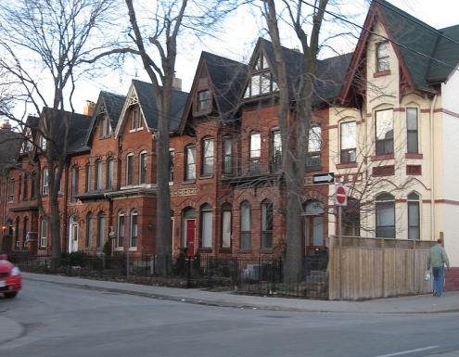
Lazy learners
‘Lazy’: Do not create a model of the training instances in advance
When an instance arrives for testing, runs the algorithm to get the class prediction
Example, K – nearest neighbour classifier
(K – NN classifier)
“One is known by the company
one keeps”

Slide 12
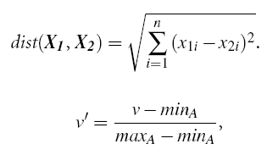
K-NN classifier schematic
For a test instance,
Calculate distances from training pts.
Find K-nearest neighbours (say, K = 3)
Assign class label based on majority

Slide 13
K-NN classifier Issues
How good is it?
Susceptible to noisy values
Slow because of distance calculation
  Alternate approaches:
  Distances to representative points only
  Partial distance
Any other modifications?
Alternatives:
Weighted attributes to decide final label
Assign distance to missing values as <max>
K=1 returns class label of nearest neighbour
How to determine value of K?
Alternatives:
Determine K experimentally. The K that gives minimum
error is selected.
How to make real-valued prediction?
Alternative:
Average the values returned by K-nearest neighbours
How to determine distances between values of categorical
attributes?
Alternatives:
Boolean distance (1 if same, 0 if different)
Differential grading (e.g. weather – ‘drizzling’ and ‘rainy’ are
closer than ‘rainy’ and ‘sunny’ )

Slide 14
Decision Lists

Slide 15
Decision Lists
A sequence of boolean functions that lead to a result
if h1 (y) = 1 then set f (y) = c1
else if h2 (y) = 1 then set f (y) = c2
…. else set f (y) = cn
f ( y ) = cj, if j = min { i | hi (y) = 1 } exists
0 otherwise

Slide 16
Decision List example
Class label
Test instance
( h i , c i )
Unit

Slide 17


Decision List learning
R
S’ = S
- Qk
( h k, )
1 / 0
If
(| Pi| - pn * | Ni |
>
|Ni| - pp *|Pi| )
then 1
else 0
For each hi,
Qi = Pi U Ni
( hi = 1 )
Set of candidate
feature functions
Select hk, the feature
with
highest utility
U i = max { | Pi| - pn * | Ni | , |Ni| - pp *|Pi| }

Slide 18
Decision list Issues
Pruning?
hi is not required if :
c _{i} = c _{(r+1)}
There is no h j ( j > i ) such that
Q i = Q j
Accuracy / Complexity tradeoff?
Size of R : Complexity (Length of the list)
S’ contains examples of both classes : Accuracy (Purity)
What is the terminating condition?
Size of R (an upper threshold)
Q_{k} = null
S’ contains examples of same class

Slide 19
Probabilistic
classifiers

Slide 20
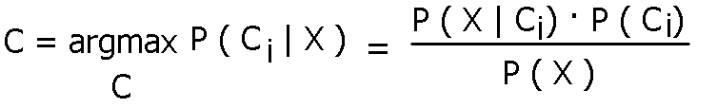
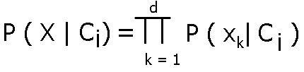
Probabilistic classifiers : NB
Based on Bayes rule
Naïve Bayes : Conditional independence assumption

Slide 21
Naïve Bayes Issues
How are different types of attributes
handled?
Discrete-valued : P ( X | Ci ) is according to
        formula
Continous-valued : Assume gaussian distribution.
      Plug in mean and variance for the attribute
      and assign it to P ( X | Ci )
Problems due to sparsity of data?
Problem : Probabilities for some values may be zero
Solution : Laplace smoothing
For each attribute value,
update probability m / n as : (m + 1) / (n + k)
where k = domain of values

Slide 22
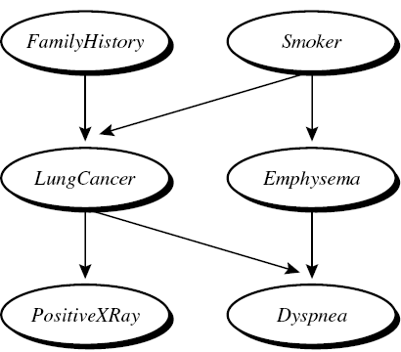
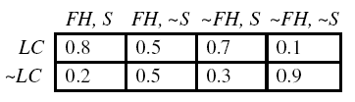

Probabilistic classifiers : BBN
Bayesian belief networks : Attributes ARE dependent
A directed acyclic graph and conditional probability tables
An added term for conditional
probability between attributes:
Diagram from Han-Kamber

Slide 23
BBN learning
(when network structure known)
Input : Network topology of BBN
Output : Calculate the entries in conditional probability table
(when network structure not known)
???

Slide 24
Learning structure of BBN
Use Naïve Bayes as a basis pattern
Add edges as required
Examples of algorithms: TAN, K2
Loan
Age
Family
status
Marital
status

Slide 25
Artificial
Neural Networks

Slide 26
Artificial Neural Networks
Based on biological concept of neurons
Structure of a fundamental unit of ANN:
w0
threshold
w1
input
output: : activation function
p (v) where
p (v) = sgn (w₀ + w₁x₁ + … + w_{n}x_{n} )
wn

Slide 27
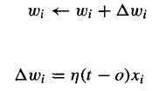
Perceptron learning algorithm
Initialize values of weights
Apply training instances and get output
Update weights according to the update rule:
Repeat till converges
Can represent linearly separable functions only
n : learning rate
t : target output
o : observed output

Slide 28


Sigmoid perceptron
Basis for multilayer feedforward networks

Slide 29
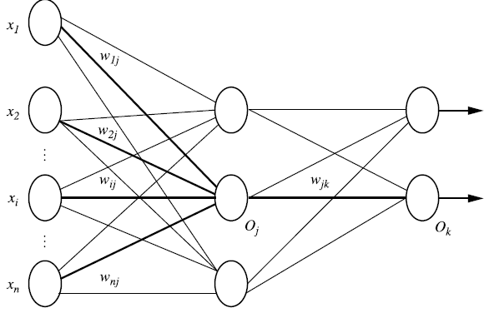
Multilayer feedforward networks
Multilayer? Feedforward?
Input layer
Hidden layer
Output layer
Diagram from Han-Kamber

Slide 30
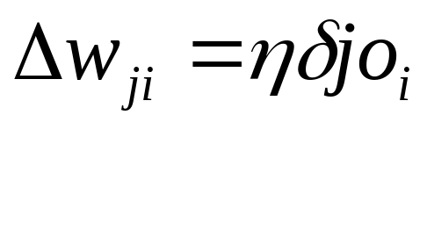

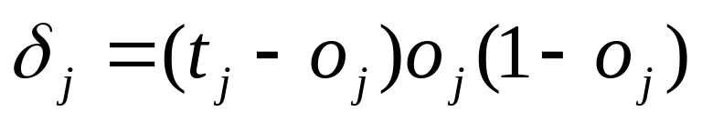
Backpropagation
Apply training instances as input and produce output
Update weights in the ‘reverse’ direction as follows:
Diagram from Han-Kamber

Slide 31
ANN Issues
Addition of momentum
But why?
Choosing the learning factor
A small learning factor means multiple iterations
required.
A large learning factor means the learner
may skip the global minimum
What are the types of learning
approaches?
Deterministic: Update weights after summing up
Errors over all examples
Stochastic: Update weights per example
Learning the structure of the network
Construct a complete network
Prune using heuristics:
  Remove edges with weights nearly zero
  Remove edges if the removal does not affect
  accuracy

Slide 32
Support vector
machines

Slide 33
Support vector machines
Basic ideas
Margin
“Maximum separating-margin classifier”
+1
Support vectors
-1
Separating hyperplane : wx+b = 0

Slide 34
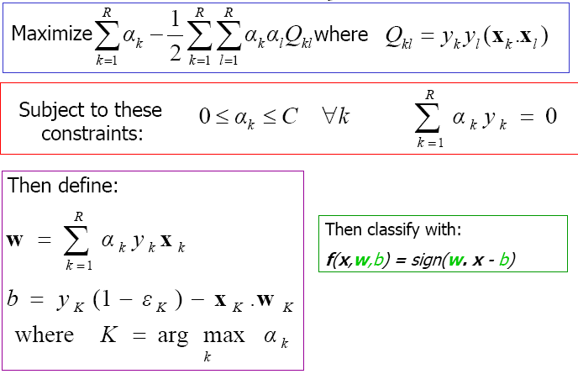
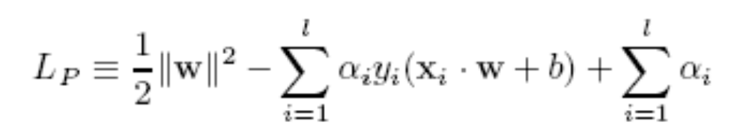
SVM training
Problem formulation
Minimize (1 / 2) || w ||²
w.r.t. (y_{i} ( w x_{i} + b ) – 1) >= 0 for all i
Lagrangian multipliers are
zero for data instances other
than support vectors
Dot product of xk and xl

Slide 35



Focussing on dot product
For non-linear separable points,
we plan to map them to a higher dimensional (and linearly separable) space
The product can be time-consuming. Therefore, we use kernel functions

Slide 36

Kernel functions
Without having to know the non-linear mapping, apply kernel function, say,
Reduces the number of computations required to generate Q kl values.

Slide 37


Testing SVM
SVM
Class
label
Test instance

Slide 38
SVM Issues
SVMs are immune to the removal of
non-support-vector points
What if n-classes are to be predicted?
Problem : SVMs deal with two-class classification
Solution : Have multiple SVMs each for one class

Slide 39
Combining
classifiers

Slide 40
Combining Classifiers
‘Ensemble’ learning
Use a combination of models for prediction
  Bagging : Majority votes
  Boosting : Attention to the ‘weak’ instances
Goal : An improved combined model

Slide 41
Bagging
Total set
Classifier
learning
scheme
Classifier
model
M 1
Majority
vote
Class Label
Training
dataset
D
Classifier
model
M n
Sample
D 1
Test
set
At random. May use bootstrap sampling with replacement

Slide 42


Boosting (AdaBoost)
Total set
Error
Classifier
learning
scheme
Classifier
model
M 1
Weighted
vote
Class Label
Training
dataset
D
Classifier
model
M n
Sample
D 1
Error
Weights of
correctly classified instances multiplied
by error / (1 – error)
If error > 0.5?
Test
set
Selection based on weight. May use bootstrap sampling with replacement
`
Initialize weights of instances to 1/d

Slide 43
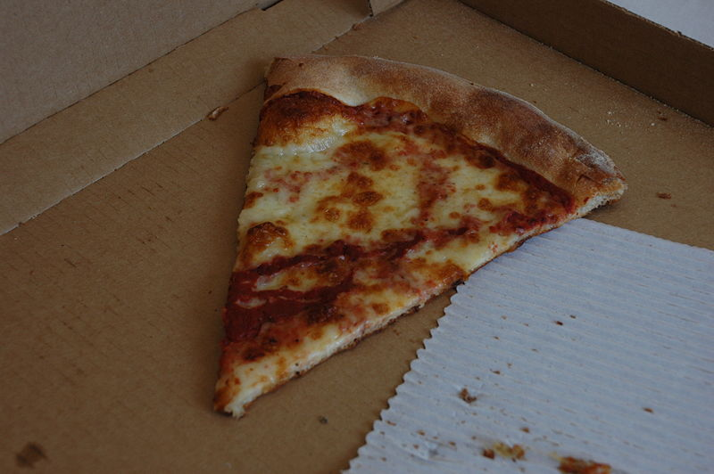
The last slice

Slide 44
Data preprocessing
Attribute subset selection
  Select a subset of total attributes to reduce complexity
Dimensionality reduction
  Transform instances into ‘smaller’ instances

Slide 45
Attribute subset selection
Information gain measure for attribute selection in decision trees
Stepwise forward / backward elimination of attributes

Slide 46
Dimensionality reduction
Number of attributes of
a data instance
High dimensions : Computational complexity
instance x in p-dimensions
s = Wx W is k x p transformation mtrx.
instance x in k-dimensions
k < p

Slide 47
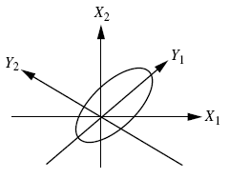



Principal Component Analysis
Computes k orthonormal vectors : Principal components
Essentially provide a new set of axes – in decreasing order of variance
Eigenvector matrix
( p X p )
First k are k PCs
( p X n )
( p X n )
(p X n)
(k X n)
(k X p)
Diagram from Han-Kamber

Slide 48
Weka &
Weka Demo

Slide 49
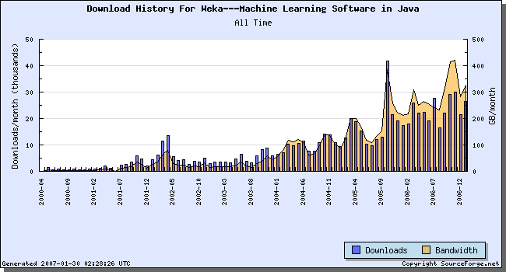
Weka & Weka Demo
Collection of ML algorithms
Get it from :
http://www.cs.waikato.ac.nz/ml/weka/
ARFF Format
‘Weka Explorer’

Slide 50
ARFF file format
Name of the relation
@RELATION nursery
@ATTRIBUTE children numeric
@ATTRIBUTE housing {convenient, less_conv, critical}
@ATTRIBUTE finance {convenient, inconv}
@ATTRIBUTE social {nonprob, slightly_prob, problematic}
@ATTRIBUTE health {recommended, priority, not_recom}
@ATTRIBUTE pr_val {recommend,priority,not_recom,very_recom,spec_prior}
@DATA
3,less_conv,convenient,slightly_prob,recommended,spec_prior
Attribute definition
Data instances : Comma separated, each on a new line

Slide 51

Parts of weka
Explorer
Basic interface to run ML
Algorithms
Experimenter
Comparing experiments
on different algorithms
Knowledge Flow
Similar to Work Flow
‘Customized’ to one’s needs

Slide 52
Learning structure of BBN
K2 Algorithm :
  Consider nodes in an order
  For each node, calculate utility to add an edge from previous nodes to this one
TAN :
  Use Naïve Bayes as the baseline network
  Add different edges to the network based on utility
Examples of algorithms: TAN, K2

Slide 53

Delta rule
Delta rule enables to converge to a best fit if points are not linearly separable
Uses gradient descent to choose the hypothesis space

Slide 54
Key References
Data Mining – Concepts and techniques; Han and Kamber, Morgan Kaufmann publishers, 2006.
Machine Learning; Tom Mitchell, McGraw Hill publications.
Data Mining – Practical machine learning tools and techniques; Witten and Frank, Morgan Kaufmann publishers, 2005.

